Slide 1

Tap Tap Search
Under the Guidance of
Ms. S. Rama Devi Associate Professor
Team:
16WH1A1205 - B.Alekhya
16WH1A1209 - A.Sai Sanjana
16WH1A1231 - K.Sanjana

Slide 2
Contents
Introduction
Problem Definition
Existing System
Proposed System
Architecture Diagram
Module(s)
Implementation
Plan of Action
Output
Conclusion
Future Scope
References

Slide 3
Introduction
It is an Android application which converts text to speech
This application is used for reading either individual paragraphs or whole documents aloud

Slide 4
Problem Definition
To create an Android application which converts text to speech in different forms that can be efficiently used by people.

Slide 5
Existing System
Manually typing a text, viewing notifications and any messages will be difficult when the user is busy
We have downloaded some of the related applications but they have bit difficult in use and disadvantages:
TapTapSee
Envision AI
CamFind
Supersense

Slide 6
Proposed System
Text to speech conversion application will always run in the background and performs operations like reading notifications efficiently.
Along with converting text to speech, this application also takes the image and recognises the text from the image.

Slide 7
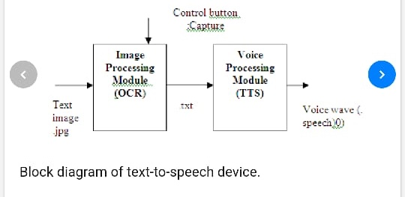
Architecture Diagram

Slide 8
Modules
Text-to-speech synthesis (TTS)
Speech-to-text
File uploader
Image processing
Notification Reader

Slide 9
Implementation
Text To Speech: The import used in Text to Speech is
“import android.speech.tts.TextToSpeech”
t1=new TextToSpeech(getApplicationContext(), new TextToSpeech.OnInitListener() {
public void onInit(int status) {
if(status != TextToSpeech.ERROR) {
t1.setLanguage(Locale.ENGLISH);
}
});

Slide 10
Speech To Text: The basic code for speech to text is
private void speak() {
Intent intent=new Intent(RecognizerIntent.ACTION_RECOGNIZE_SPEECH);
intent.putExtra(RecognizerIntent.EXTRA_LANGUAGE_MODEL,RecognizerIntent.LANGUAGE_MODEL_FREE_FORM);
intent.putExtra(RecognizerIntent.EXTRA_LANGUAGE, Locale.getDefault());
intent.putExtra(RecognizerIntent.EXTRA_PROMPT, "Hi speak something");

Slide 11
File To Speech: In order to get access we need to add permission in manifest file
“android.Manifest.permission.READ_EXTERNAL_STORAGE”
intent.setAction(Intent.ACTION_GET_CONTENT);
tv.setText(br.toString());
MyService.mTts.speak(br.toString(), TextToSpeech.QUEUE_FLUSH, null);

Slide 12
Image To Speech: In order to recognize text from camera we need add the content in Gradle Build is “com.google.android.gms.vision.CameraSource;”
“com.google.android.gms.vision.text.TextRecognizer;”
mCameraSource = new CameraSource.Builder(getApplicationContext(), textRecognizer)
.setFacing(CameraSource.CAMERA_FACING_BACK)
.setRequestedPreviewSize(1280, 1024)
.setAutoFocusEnabled(true)
.setRequestedFps(2.0f) .build();

Slide 13
Notification: The imports used in notification reader is
“android.content.BroadcastReceiver”
“android.telephony.SmsMessage”
String mobile = x.getOriginatingAddress();
String msgbody = x.getMessageBody().toString().trim().toUpperCase();
String msg = "hi you got a text message from "+mobile+" and the message is "+msgbody;
Toast.makeText(context, msg, Toast.LENGTH_LONG).show();
MyService.mTts.speak(msg, TextToSpeech.QUEUE_FLUSH, null);

Slide 14
Technologies Used
Android Studio version 3.5
Java
TTS (Text To Speech)

Slide 15
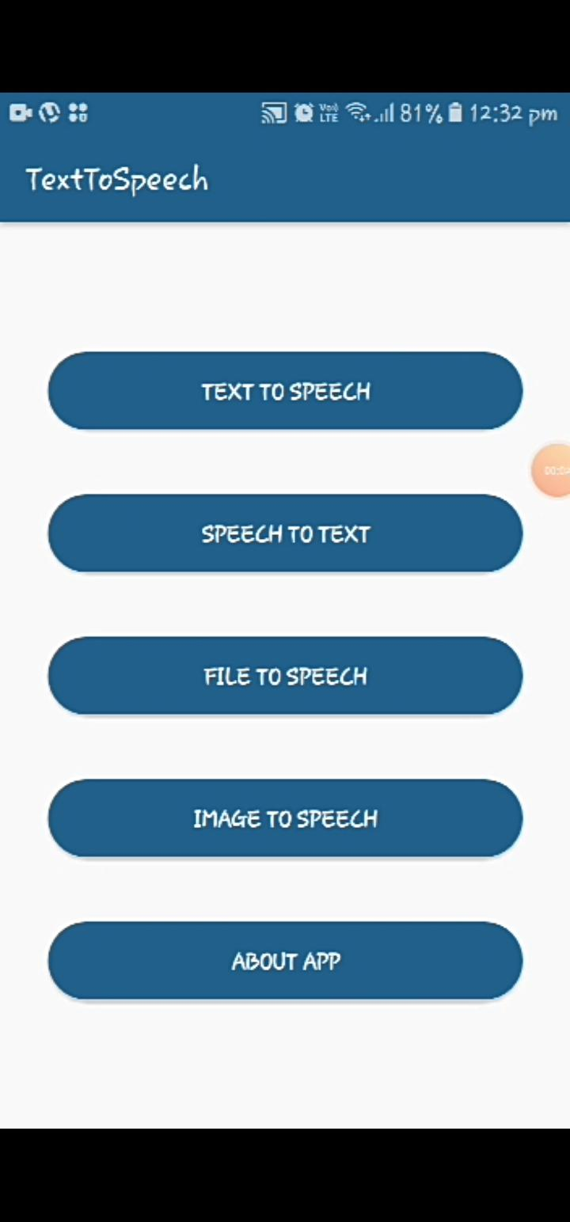
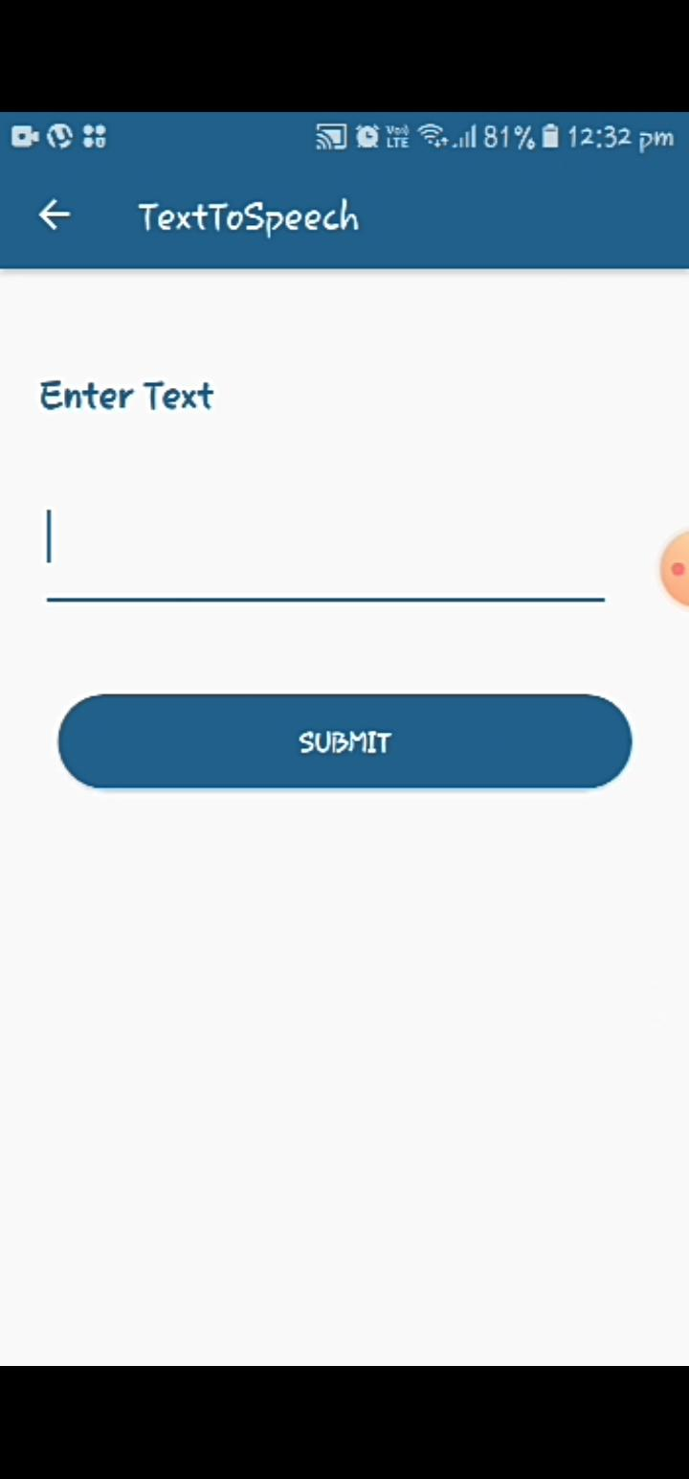
Output
Home Page
Text To Speech

Slide 16
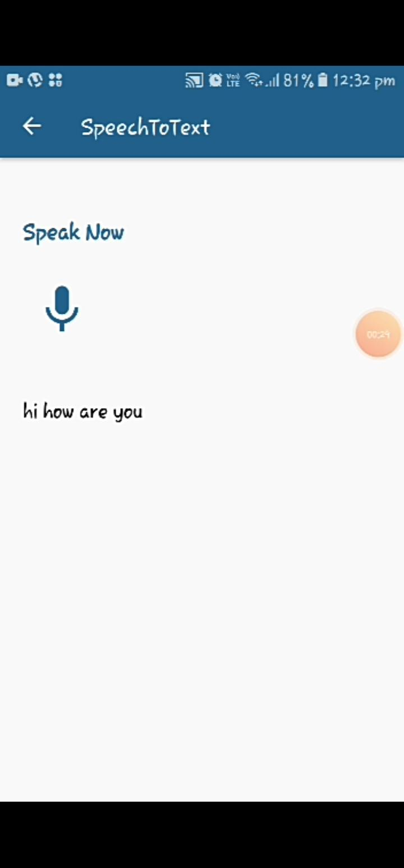
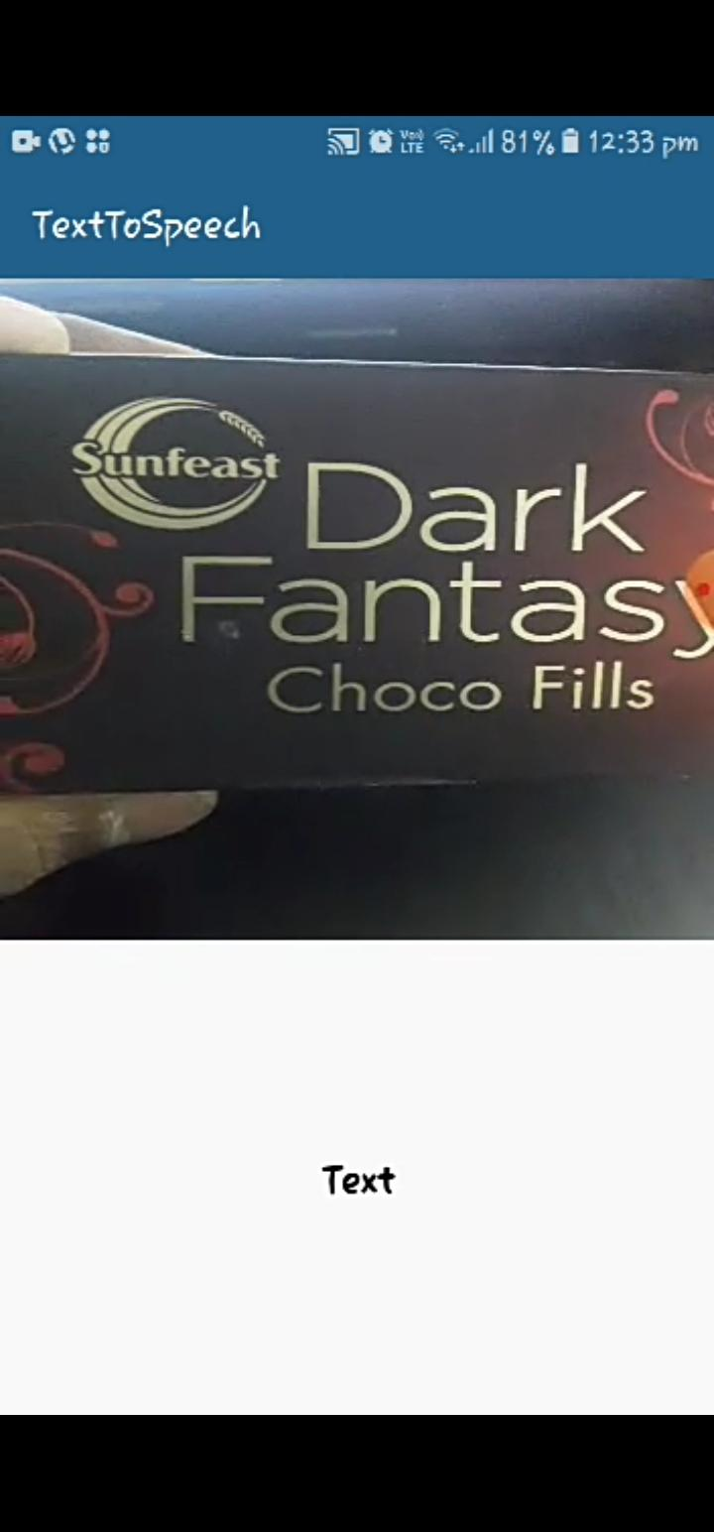
Speech To Text
Image To Text

Slide 17
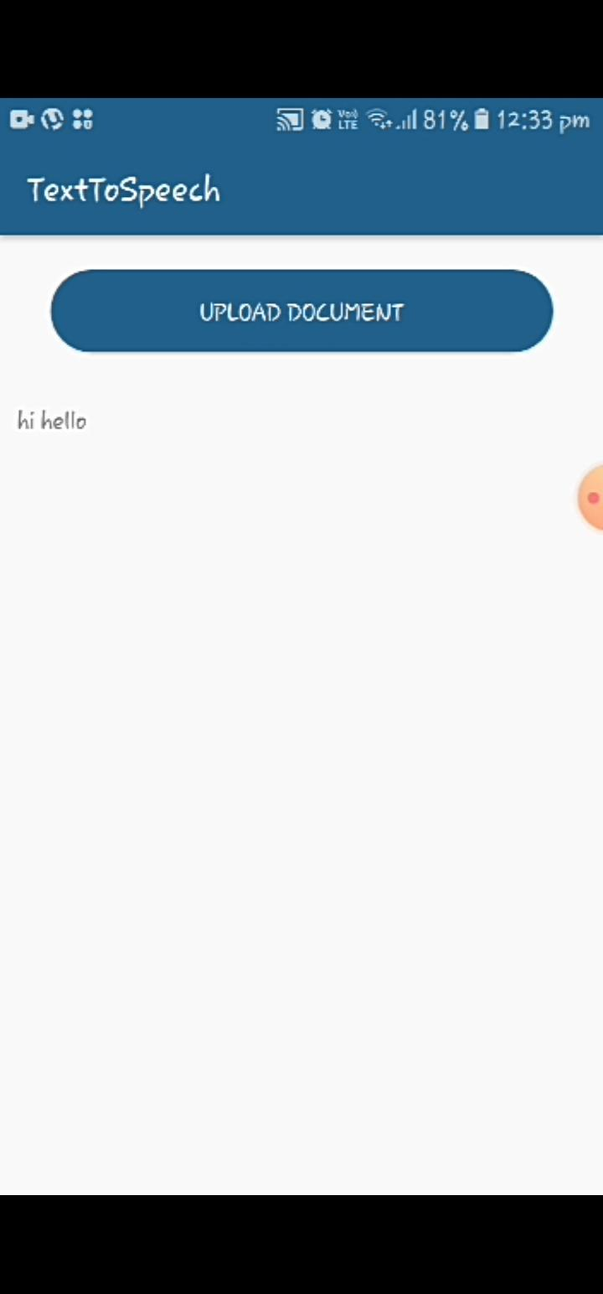
File Uploading

Slide 18

Output Video

Slide 19
Action Plan
Module Information | Status | Time required to Complete
Literature Survey | Completed Natural Reader Text 2 speech Tap Tap search Super sense | -
Requirement Analysis | completed Installed Android application Gathered all related papers | -
Design | completed Designed text to speech conversion Working on how to upload files into app | 3 Weeks(25-01-2019 to 12-02-2020)
Implementation | completed Text to Speech & Speech to text pages are done, Notification reader,File uploader,Image processor. | 4 Weeks(13-02-2020 to 12-03-2020)
Documentation | Done | 2 Weeks(13-03-2020 to 24-03-2020)
Final Submission
Status

Slide 20
Conclusion
Text to speech and speech to text synthesis is a rapidly growing aspect of computer technology and is increasingly playing a more important role in the way we interact with the system and interfaces across a variety of platforms. We have developed a very simple and attractive graphical user interface which allows the user to type text to convert it into speech, converts the speech to text, allows the user to upload text files,read out the text from the image and the android read out the text messages the user receives.

Slide 21
Future scope
In future, we plan to work on the implementation of a text to speech system on other platforms, such as telephony systems, ATM machines, video games and any other platforms where text to speech technology would be an added advantage and increase functionality.

Slide 22
References
Base Paper - https://core.ac.uk/download/pdf/83592918.pdf
[1]https://www.tutorialspoint.com/android/android_text_to_speech.htm
[2]https://www.researchgate.net/publication/282268546_Text_to_Speech_Conversion_System_using_OCR
[3]https://www.techradar.com/in/news/the-best-free-text-to-speech-software
[4]https://www.engpaper.com/voice-recognition.htm
[5]https://www.researchgate.net/publication/313389686_Text_to_speech_conversion

Slide 23


